Slide 1





HackOrbit 2025
ProctoVision by
AIvengers
Domain:
Artificial Intelligence and Machine Learning

Slide 2

THEME & PROBLEM STATEMENT
THEME
Ethical AI and Social Good — Leveraging AI for responsible proctoring and public safety.
PROBLEM STATEMENT
Online and offline exams, interviews, and secure zones are at risk of cheating and unauthorized actions.
Manual monitoring is slow, requires a lot of effort, and can’t easily scale to large numbers.
No current solution offers real-time, privacy-first, edge AI monitoring that respects user privacy and is easy to use.
Existing tools lack a combined approach for object detection, instant alerts, and secure log management in a user-friendly web interface.

Slide 3

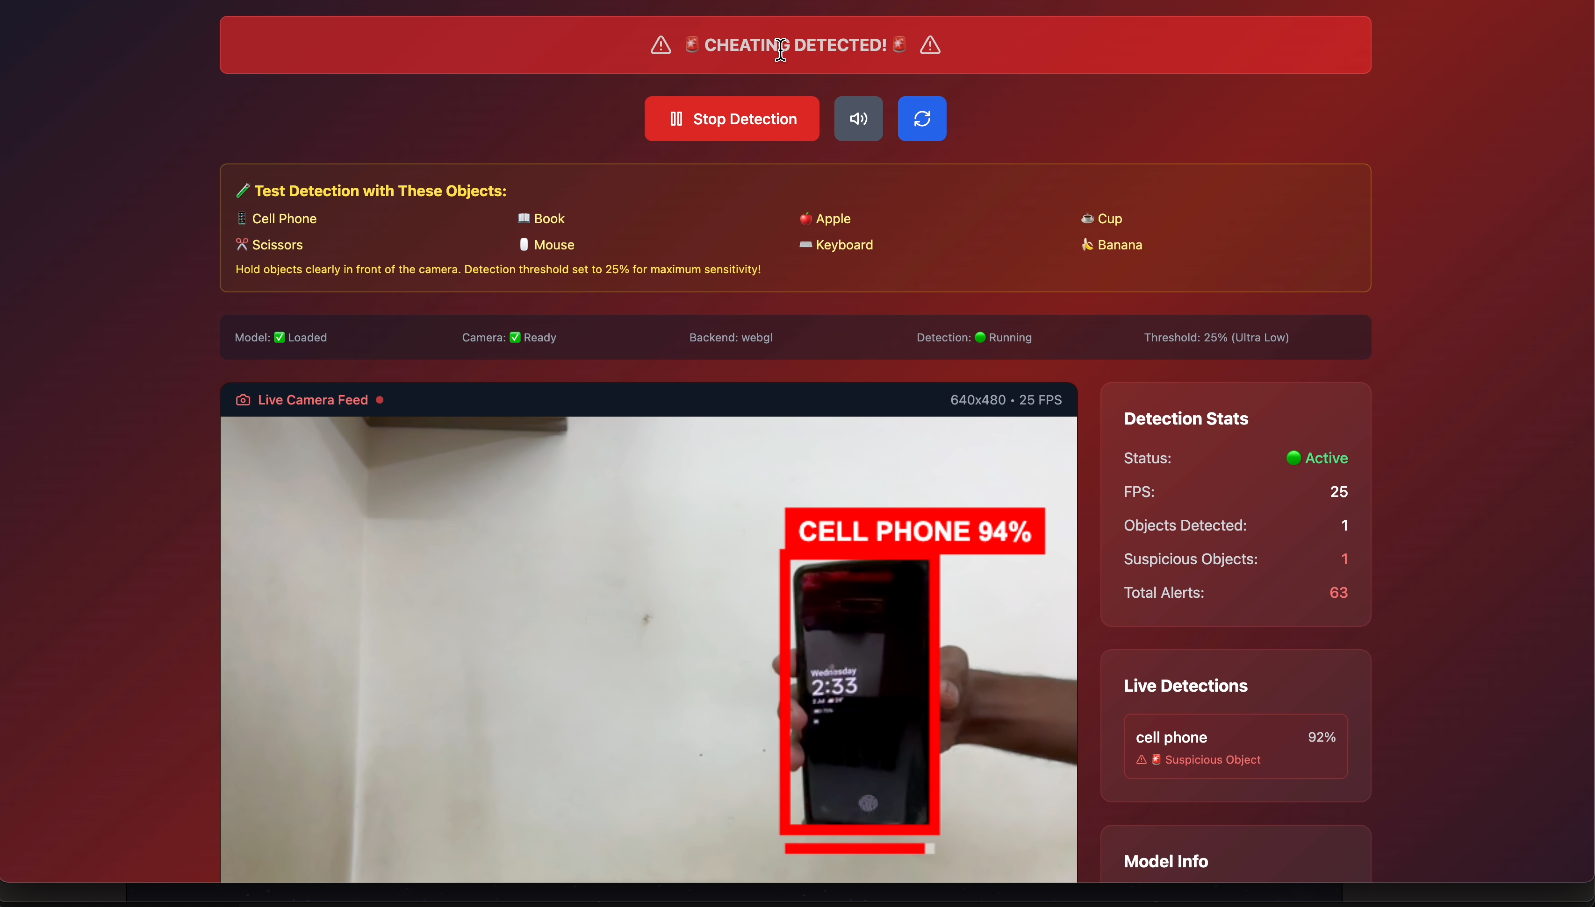
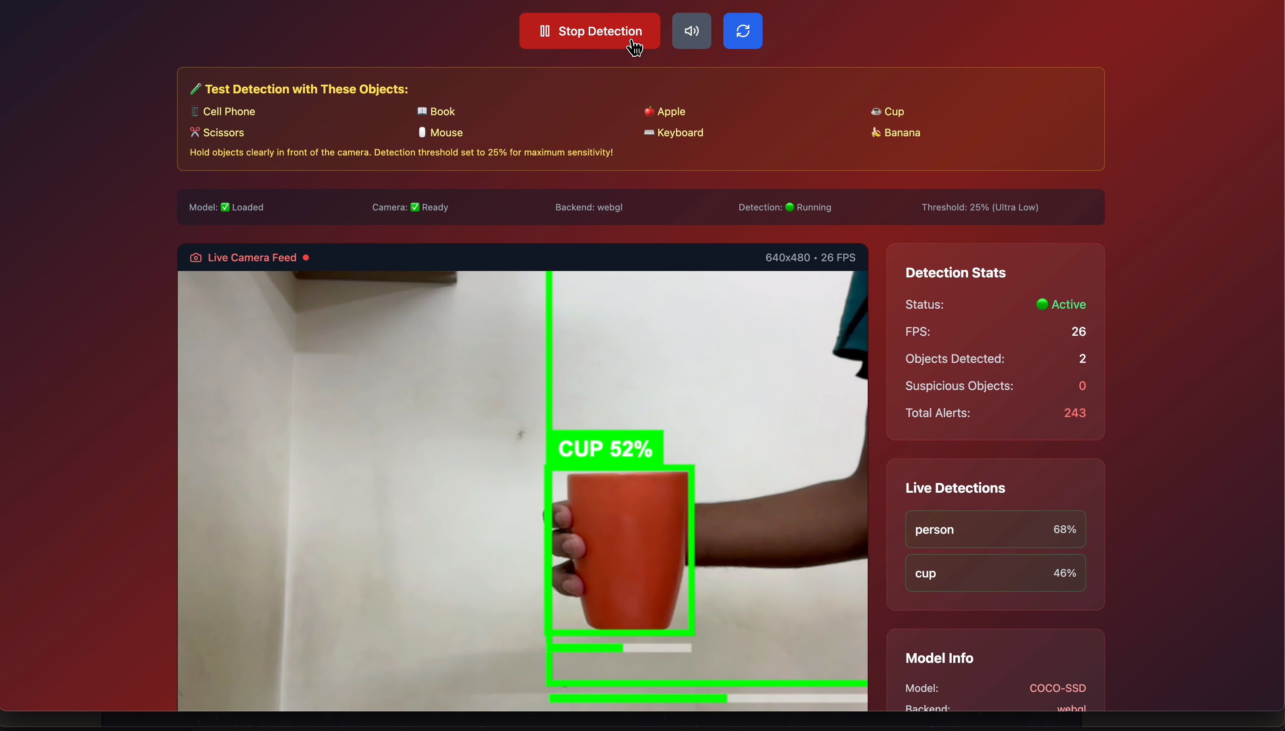
PROPOSED SOLUTION
A lightweight, AI-powered web app using YOLO and TensorFlow.js for instant suspicious object detection.
Detects items like phones, books, notes, or any custom-defined objects directly from the webcam — all in real time.
Impact: Can reduce manual monitoring by up to 80%, ensure privacy-first compliance, and scale across EdTech & corporate sectors.
Key Functionalities
Customizable object classes: Choose what counts as “suspicious” for your scenario.
Zero-latency alerts: Instant on-screen warnings and audio cues for immediate action.
Event logging: Every detection is logged with time, confidence, and export options for audits.
Designed for: EdTech, exam proctoring, secure workplaces, and public safety.

Slide 4

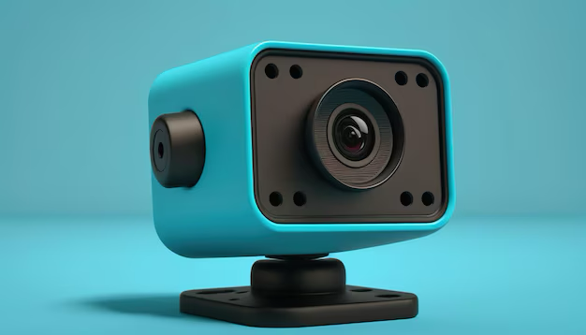

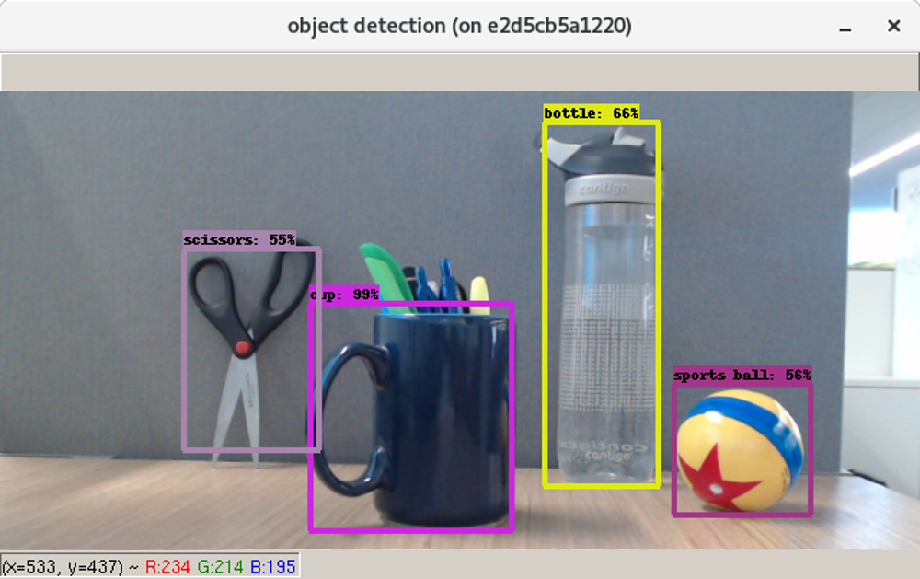



FLOWCHART / DIAGRAM
WARNING
Webcam access is requested securely
Suspicious object
WEBCAM
OBJECT DETECTION MODEL
Detecting Object
OBJECT DETECTION
Storing all detecting loggs in cloud
TensorFlow.js loads the YOLOv8 model
SECURE CLOUD LOGGING
TENSORFLOW.JS
REAL-TIME SUSPICIOUS OBJECT DETECTION SYSTEM

Slide 5






How It Works (Step-by-Step)
User opens VisionSentinel in their browser (no install needed).
Webcam access is requested securely.
TensorFlow.js loads the YOLOv8 model (or COCO-SSD as fallback).
WebGL/WebGPU/ONNX Runtime accelerates AI inference for real-time detection.
Each video frame is analyzed for suspicious objects (e.g., cell phone).
If a suspicious object is detected:
Visual bounding box appears on screen.
Audio/visual alert is triggered instantly.
Detection event is logged locally (object, confidence, timestamp).
User or admin can view, filter, and export logs for audits or reports.
Optional: Logs can be securely synced to a cloud dashboard for large-scale monitoring and analytics.
All AI runs locally unless cloud sync is enabled — ensuring privacy-first operation.
TECHNOLOGY STACK
React.js, TypeScript, Chakra UI - Modern, responsive, component-based web UI
TensorFlow.js, ONNX Runtime Web- In-browser, hardware-accelerated AI model execution
Howler.js (audio), Custom overlay components- Instant user feedback on detection events
JSON/CSV export, D3.js/Chart.js - Data export and optional visualization

Slide 6

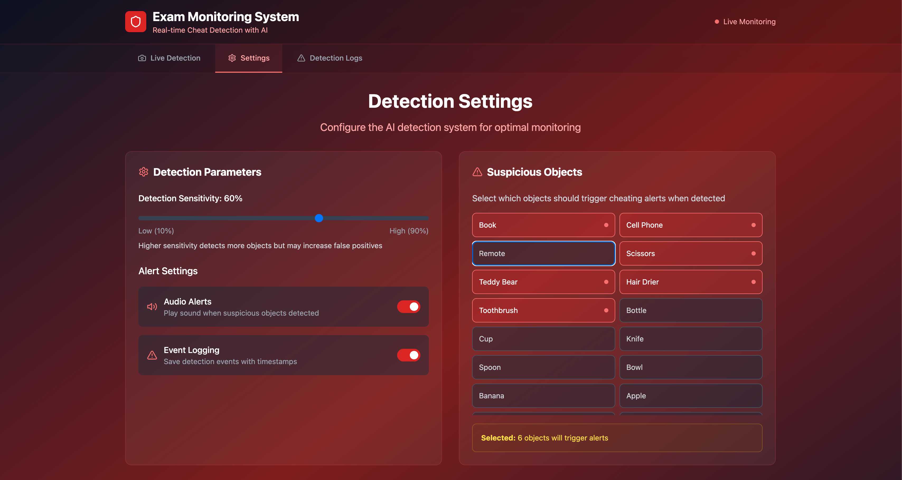
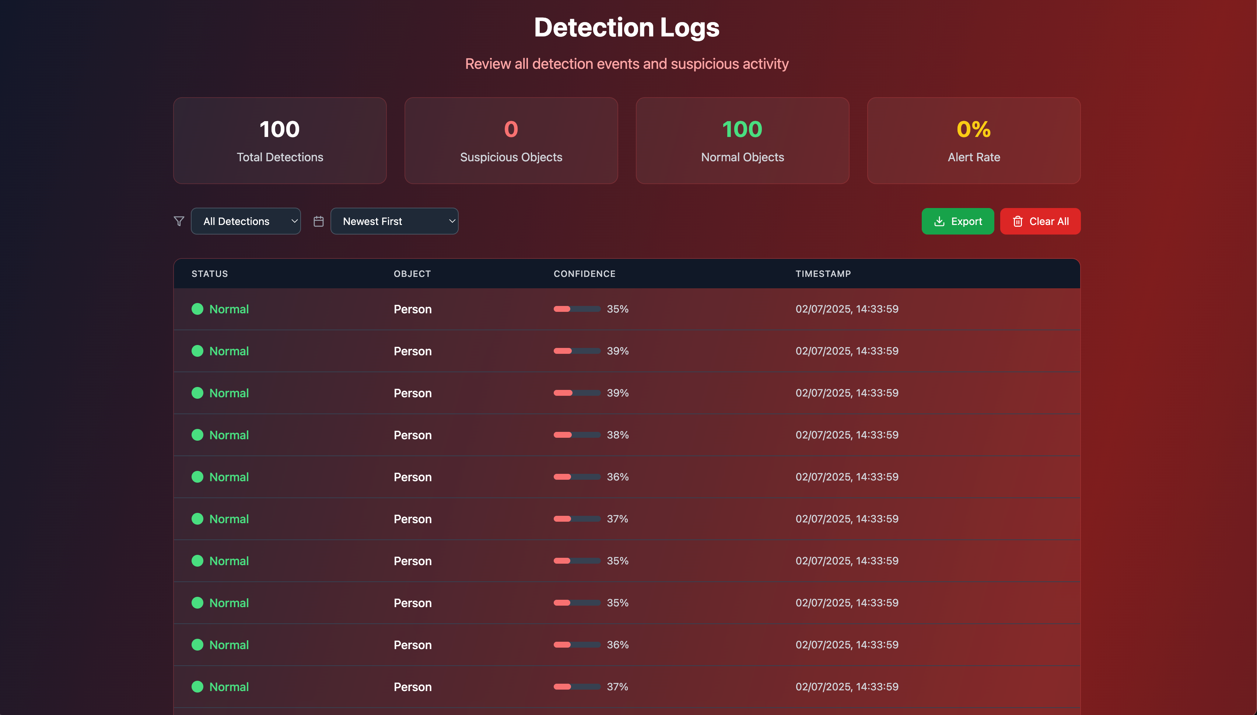
FEATURES AND NOVELTY
Real-Time Object Detection: Instantly spots phones, books, and more using YOLO + TensorFlow.js — all in-browser, no lag.
Web-Based & Lightweight: Works on any modern browser, no installation, no extra hardware.
Edge AI Deployment: All AI runs locally, ensuring zero-latency and total privacy.
Customizable Detection: Users pick which objects to monitor for flexible, tailored protection.
Alert System: Combines audio and visual cues for immediate, clear feedback.
Log Exporting: Easily export detection logs in JSON for audits or analytics.
Human-Centric UI: Simple, intuitive interface designed for real classrooms and offices.

Slide 7
DRAWBACK AND SHOWSTOPPERS
⚠️ Current Limitations
Lighting Dependency: Detection accuracy drops in poor lighting or cluttered backgrounds.
Model Limitations: Uses a general-purpose COCO model, so might miss very custom cheating objects (like micro-notes).
Device Limitations: May run slower on older phones or low-end devices.
User Permissions: Needs active browser tab and camera access (per browser security policy).
🔧 Planned Fixes
Upgrade to YOLOv8 for better accuracy and speed.
Add WebGPU and ONNX Runtime for faster, hardware-accelerated detection.
Fine-tune models with exam-specific datasets for higher detection rates.
Offer optional, secure cloud logging and an admin dashboard for large-scale deployment.
🔮 Future Scope
• Voice Detection for speaking alerts
• Mobile device support
• Multilingual UI for wide adoption
Real-time admin dashboard

Slide 8
AIvengers
Name of team members and their contact details
Team Leader Name: Aishwarya Girish
Branch- B.E Stream: ISE Year II
Email- aishwaryagirish1211@gmail.com Phone: +917019598931
Team Member Name: Anikesh Kumar
Branch- B.E Stream: ISE Year II
Email- anikeshkr0001@gmail.com Phone: +919507071557

Slide 9
Thank you

